Slide 1
API Testing
Overview of API
By Hoang.Vu

Slide 2
Agenda
 | API Overview
 | Type of APIs (Rest vs Soap)
 | Type of Methods in API
 | Header & Response
 | Q & A
1
2
3
4
5

Slide 3
API Overview
01

Slide 4
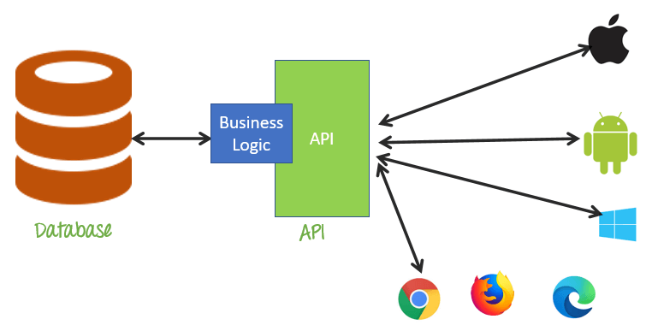
API
Application Programing Interface (API).
API is a collection of software functions & procedures.
To communicate with other products and services without having to know how they’re implemented.

Slide 5
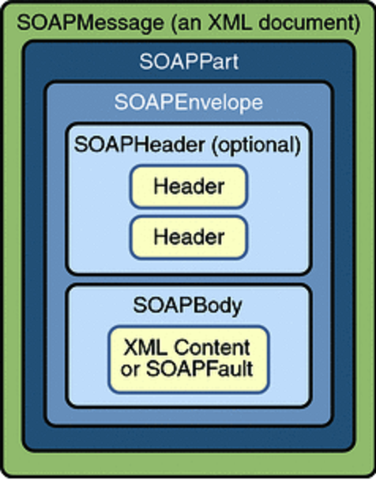
SOAP API
SOAP is the Simple Object Access Protocol.
SOAP uses an XML data format to declare its request and response messages.

Slide 6
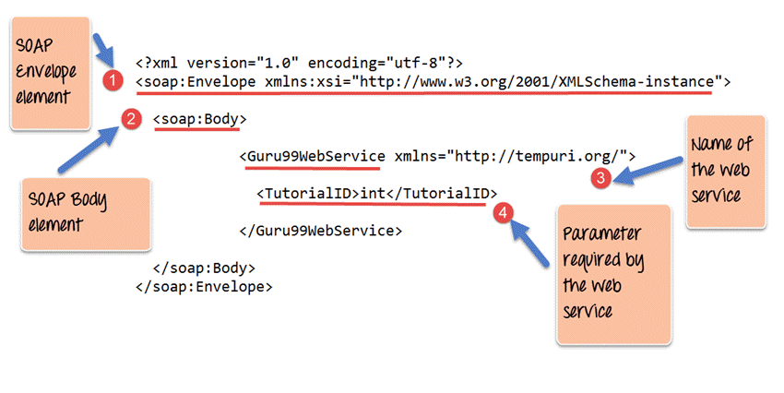
SOAP API Message
soap:Envelope.
soap:Header.
soap:Body.
soap:Fault.

Slide 7
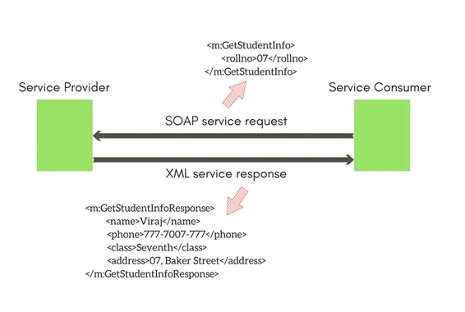
Soap API model
Soap API

Slide 8

Rest API
REST stands for Representational State Transfer.
Information format includes: Text, XML, Json, Javascript, Html.
Using HTTP protocol to send request.

Slide 9
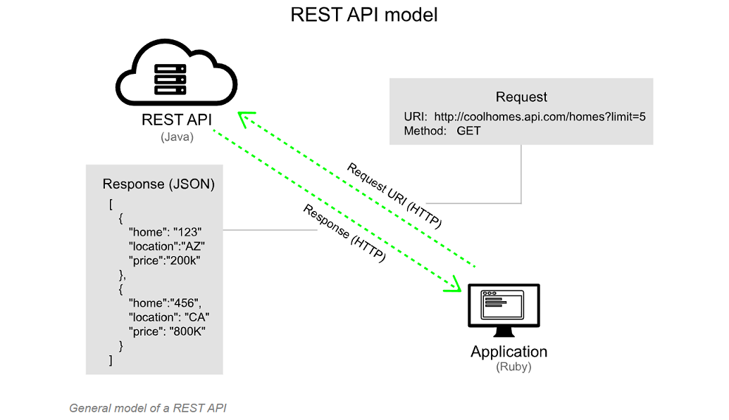
Rest API model
Rest API

Slide 10
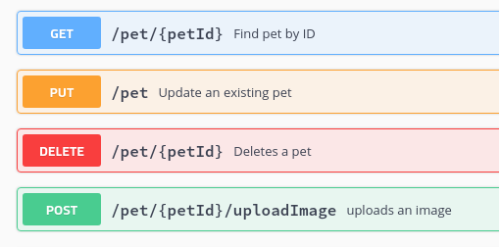
Api Methods

Slide 11
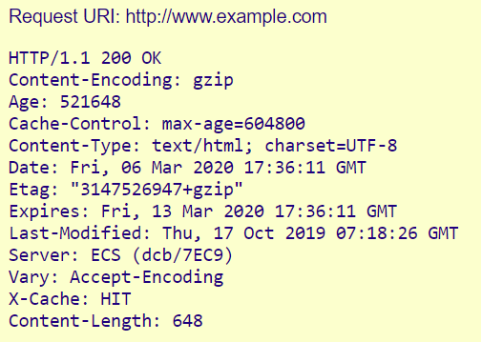
API Header
Header is to represent the meta-data associated with an API request and response.
Header tell you about:
Request and Response Body
Request Authorization
Response Caching
Response Cookies

Slide 12
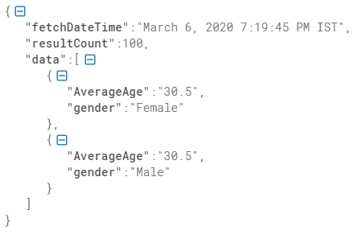
API Response
Response tell you about:
Http Status Codes
Response Header
Response Body

Slide 13
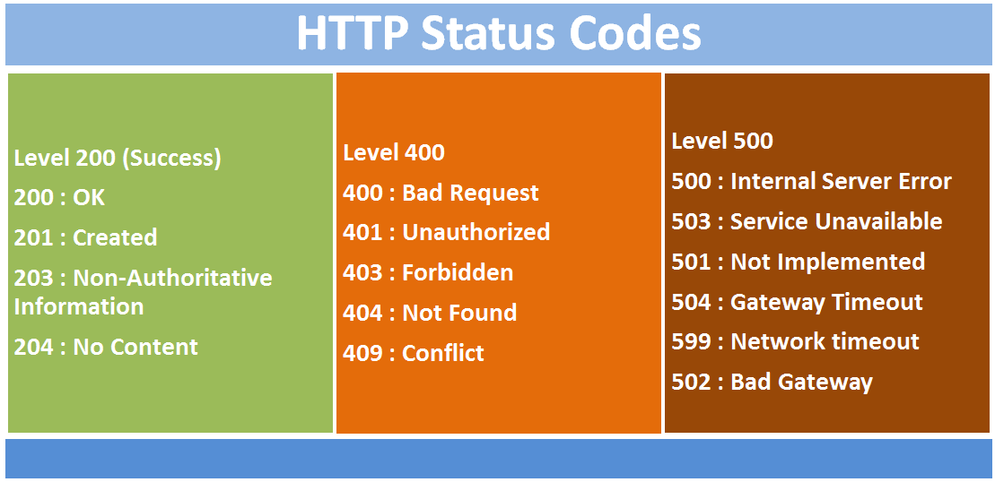
Response Codes

Slide 14

Q&A

